Slide 1
Basic Life Support
Seyed Pouya Paknezhad, MD
Assistant professor of emergency medicine
TUOMS

Slide 9
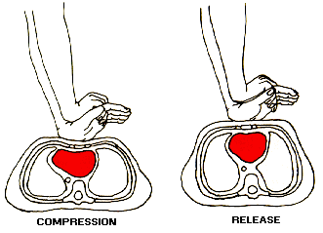
Push hard ( at least for 5 cm)
Push fast ( push for 100-120 /min )
Let the chest for recoil
Minimize interruption
Avoid hyperventilation

Slide 11
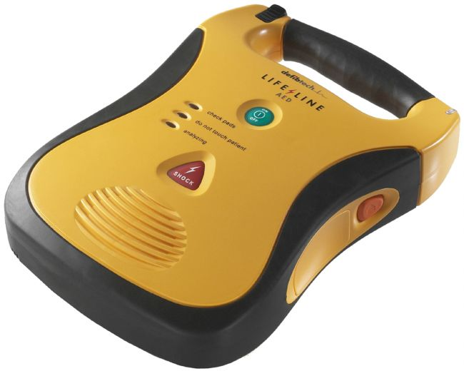

Slide 13
Questions?????

